Slide 1
Deep Learning
Exercise 1
Amir Keren 26.11.17

Slide 2
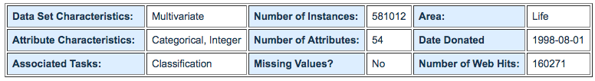
Forest Covertype Dataset
https://archive.ics.uci.edu/ml/datasets/covertype

Slide 3
Dataset Information
Predicting forest cover type from cartographic variables only (no remotely sensed data). The actual forest cover type for a given observation (30 x 30 meter cell) was determined from US Forest Service (USFS) Region 2 Resource Information System (RIS) data. Independent variables were derived from data originally obtained from US Geological Survey (USGS) and USFS data
This study area includes four wilderness areas located in the Roosevelt National Forest of northern Colorado. These areas represent forests with minimal human-caused disturbances, so that existing forest cover types are more a result of ecological processes rather than forest management practices

Slide 4
Attribute Information
Elevation / quantitative /meters / Elevation in meters
Aspect / quantitative / azimuth / Aspect in degrees azimuth
Slope / quantitative / degrees / Slope in degrees
Horizontal_Distance_To_Hydrology / quantitative / meters / Horz Dist to nearest surface water features
Vertical_Distance_To_Hydrology / quantitative / meters / Vert Dist to nearest surface water features
Horizontal_Distance_To_Roadways / quantitative / meters / Horz Dist to nearest roadway
Hillshade_9am / quantitative / 0 to 255 index / Hillshade index at 9am, summer solstice

Slide 5
Attribute Information - Cont
Hillshade_Noon / quantitative / 0 to 255 index / Hillshade index at noon, summer solstice
Hillshade_3pm / quantitative / 0 to 255 index / Hillshade index at 3pm, summer solstice
Horizontal_Distance_To_Fire_Points / quantitative / meters / Horz Dist to nearest wildfire ignition points
Wilderness_Area (4 binary columns) / qualitative / 0 (absence) or 1 (presence) / Wilderness area designation
Soil_Type (40 binary columns) / qualitative / 0 (absence) or 1 (presence) / Soil Type designation

Slide 6
Label Information
Cover_Type (7 types) / integer / 1 to 7 / Forest Cover Type designation
1 -- Spruce/Fir 2 -- Lodgepole Pine 3 -- Ponderosa Pine 4 -- Cottonwood/Willow 5 -- Aspen 6 -- Douglas-fir 7 -- Krummholz

Slide 7
Model Architecture
ReLu
ReLu
Softmax
Input - 54 attributes
Output - One-Hot-Encoded label
...
...
...
...
512 nodes
512 nodes
7 nodes

Slide 8
Grid Search Parameters
32 minibatch size, 50 epochs, 3 max norm constraint (36 combinations, ~40 min per run)
Learning Rate | Regularization | Regularization Type | Keep Probability | Training Loss | Validation Accuracy | Test Accuracy
0.1 | 0.01 | L2 | 0.75 | 0.0308 | 0.853 | 0.85
0.1 | 0.01 | L1 | 0.75 | 0.0309 | 0.853 | 0.85
0.1 | 1 | L2 | 0.75 | 0.0312 | 0.852 | 0.85
0.1 | 1 | L1 | 0.75 | 0.0314 | 0.851 | 0.85
0.1 | 0.1 | L1 | 0.75 | 0.0313 | 0.851 | 0.85
0.1 | 0.1 | L2 | 0.75 | 0.0315 | 0.849 | 0.85
0.1 | 0.1 | L1 | 0.5 | 0.0359 | 0.827 | 0.83
0.1 | 0.01 | L2 | 0.5 | 0.0358 | 0.826 | 0.83
0.1 | 1 | L1 | 0.5 | 0.0362 | 0.826 | 0.82
0.1 | 1 | L2 | 0.5 | 0.0365 | 0.825 | 0.82
0.1 | 0.1 | L2 | 0.5 | 0.0367 | 0.825 | 0.82
0.1 | 0.01 | L1 | 0.5 | 0.0363 | 0.825 | 0.82

Slide 9
Grid Search Parameters - Cont
Learning Rate | Regularization | Regularization Type | Keep Probability | Training Loss | Validation Accuracy | Test Accuracy
0.01 | 0.01 | L2 | 0.75 | 0.05 | 0.756 | 0.76
0.01 | 0.1 | L1 | 0.75 | 0.0499 | 0.755 | 0.76
0.01 | 1 | L1 | 0.75 | 0.0501 | 0.754 | 0.75
0.01 | 0.01 | L1 | 0.75 | 0.0501 | 0.754 | 0.75
0.01 | 1 | L2 | 0.5 | 0.0507 | 0.75 | 0.75
0.01 | 0.01 | L2 | 0.5 | 0.0509 | 0.749 | 0.75
0.01 | 1 | L1 | 0.5 | 0.0509 | 0.749 | 0.75
0.01 | 0.1 | L1 | 0.5 | 0.0508 | 0.749 | 0.75
0.01 | 0.01 | L1 | 0.5 | 0.0509 | 0.749 | 0.75
0.01 | 0.1 | L2 | 0.5 | 0.051 | 0.748 | 0.75
0.01 | 1 | L2 | 0.75 | 0.0522 | 0.74 | 0.74
0.01 | 0.1 | L2 | 0.75 | 0.0531 | 0.738 | 0.74

Slide 10
Grid Search Parameters - Cont
Learning Rate | Regularization | Regularization Type | Keep Probability | Training Loss | Validation Accuracy | Test Accuracy
0.001 | 0.1 | L2 | 0.75 | 0.0623 | 0.696 | 0.7
0.001 | 0.01 | L1 | 0.75 | 0.063 | 0.696 | 0.7
0.001 | 0.01 | L2 | 0.75 | 0.063 | 0.695 | 0.7
0.001 | 1 | L1 | 0.75 | 0.0627 | 0.694 | 0.7
0.001 | 0.1 | L1 | 0.75 | 0.0627 | 0.693 | 0.7
0.001 | 1 | L2 | 0.75 | 0.0635 | 0.689 | 0.69
0.001 | 1 | L1 | 0.5 | 0.0643 | 0.679 | 0.68
0.001 | 0.1 | L2 | 0.5 | 0.0649 | 0.675 | 0.68
0.001 | 0.01 | L2 | 0.5 | 0.0652 | 0.671 | 0.67
0.001 | 0.01 | L1 | 0.5 | 0.0654 | 0.671 | 0.67
0.001 | 1 | L2 | 0.5 | 0.065 | 0.669 | 0.67
0.001 | 0.1 | L1 | 0.5 | 0.0653 | 0.668 | 0.67

Slide 11
Final Run
Epochs = 600
Minibatch Size = 32
Learning Rate = 0.1
Keep Probability = 0.75
L2 Regularization = 0.01
Max Norm Constraint = 3
(~8 Hours Runtime)
Training Loss: 0.0121
Validation Accuracy: 0.936
Test Accuracy: 0.94

Slide 12
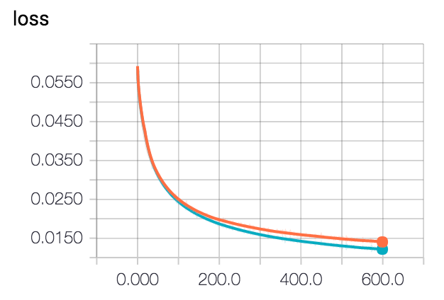
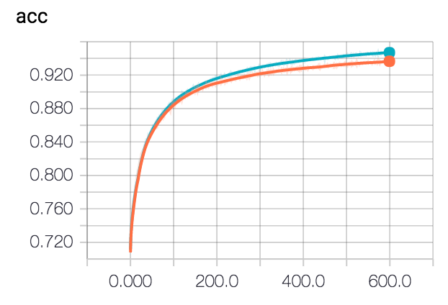
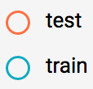
Tensorboard Results

